Slide 1

Microprocessor and microcontroller Laboratory
Smart Road Management System
Group-4
011191271
011192128
011201275
011201300
011201420
Pallab Kumar Paroi
Siyam Ahmed
Shariar Rifat
Mobarok Ali
Radowan Ahmed

Slide 2
Project Overview
Traffic management is a critical aspect of urban infrastructure, ensuring the smooth flow of vehicles and pedestrians while enhancing safety and efficiency. Traditional traffic management systems often rely heavily on manual intervention, leading to inefficiencies and delays. In response to these challenges, we propose the development of an Automated Traffic Management System (ATMS) equipped with innovative features to optimise traffic flow and enhance safety.

Slide 3
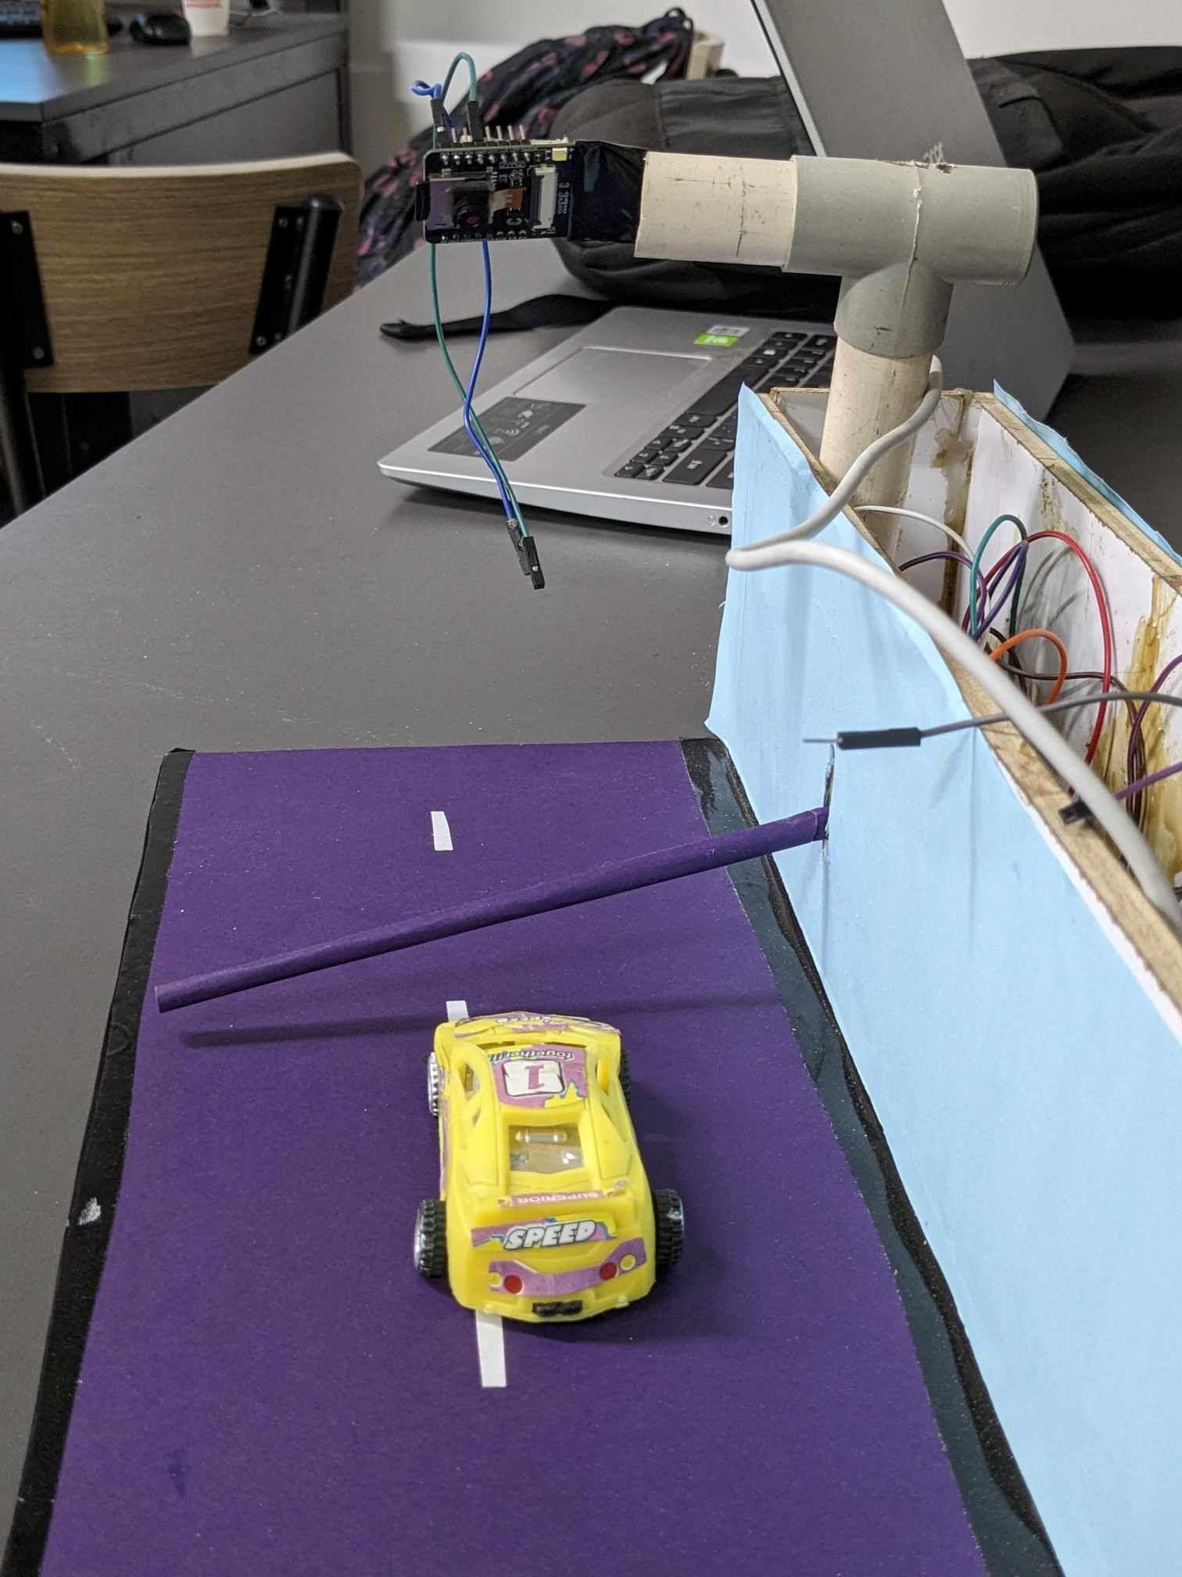
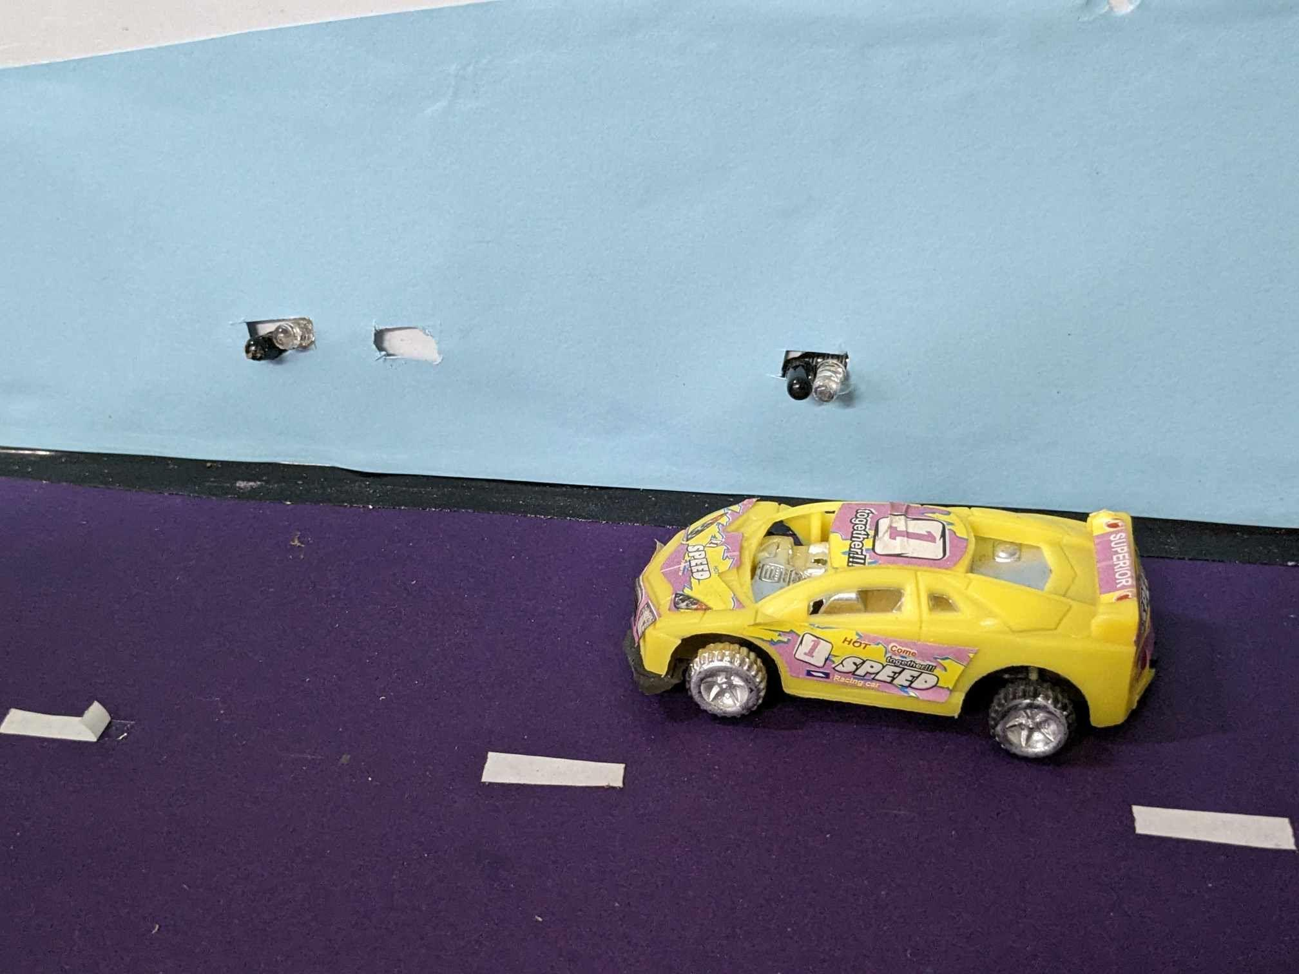
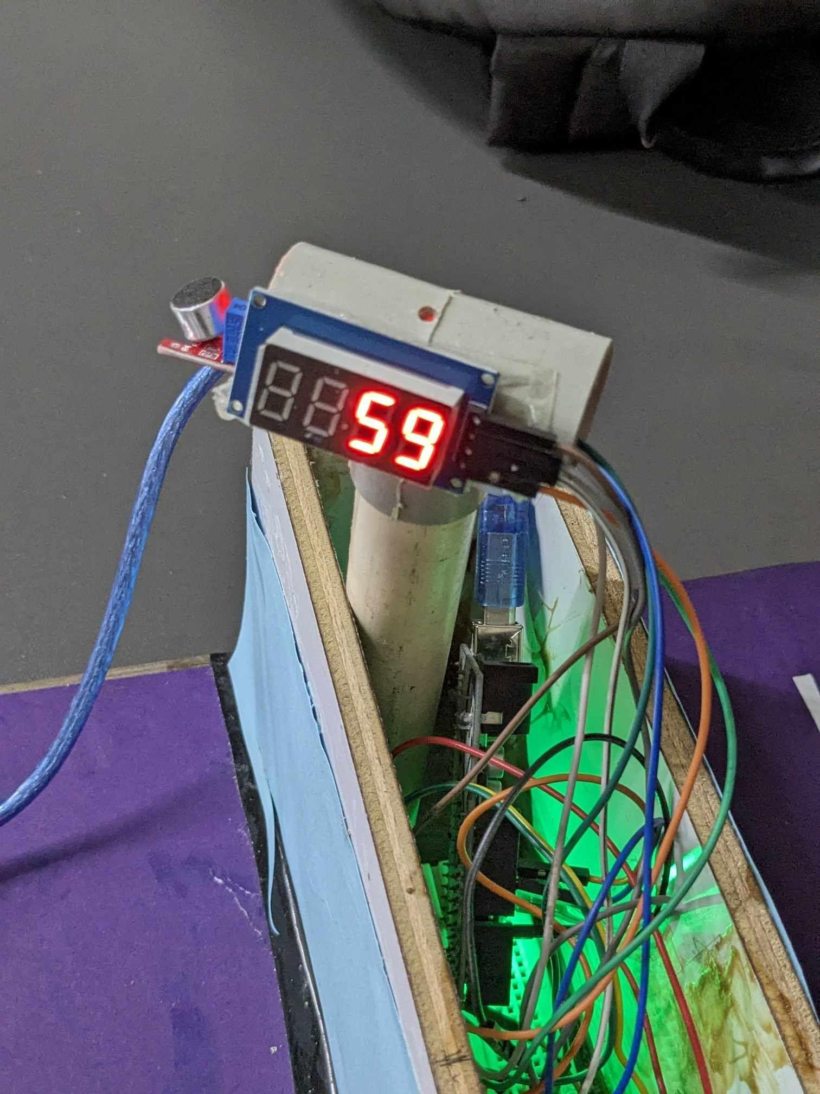
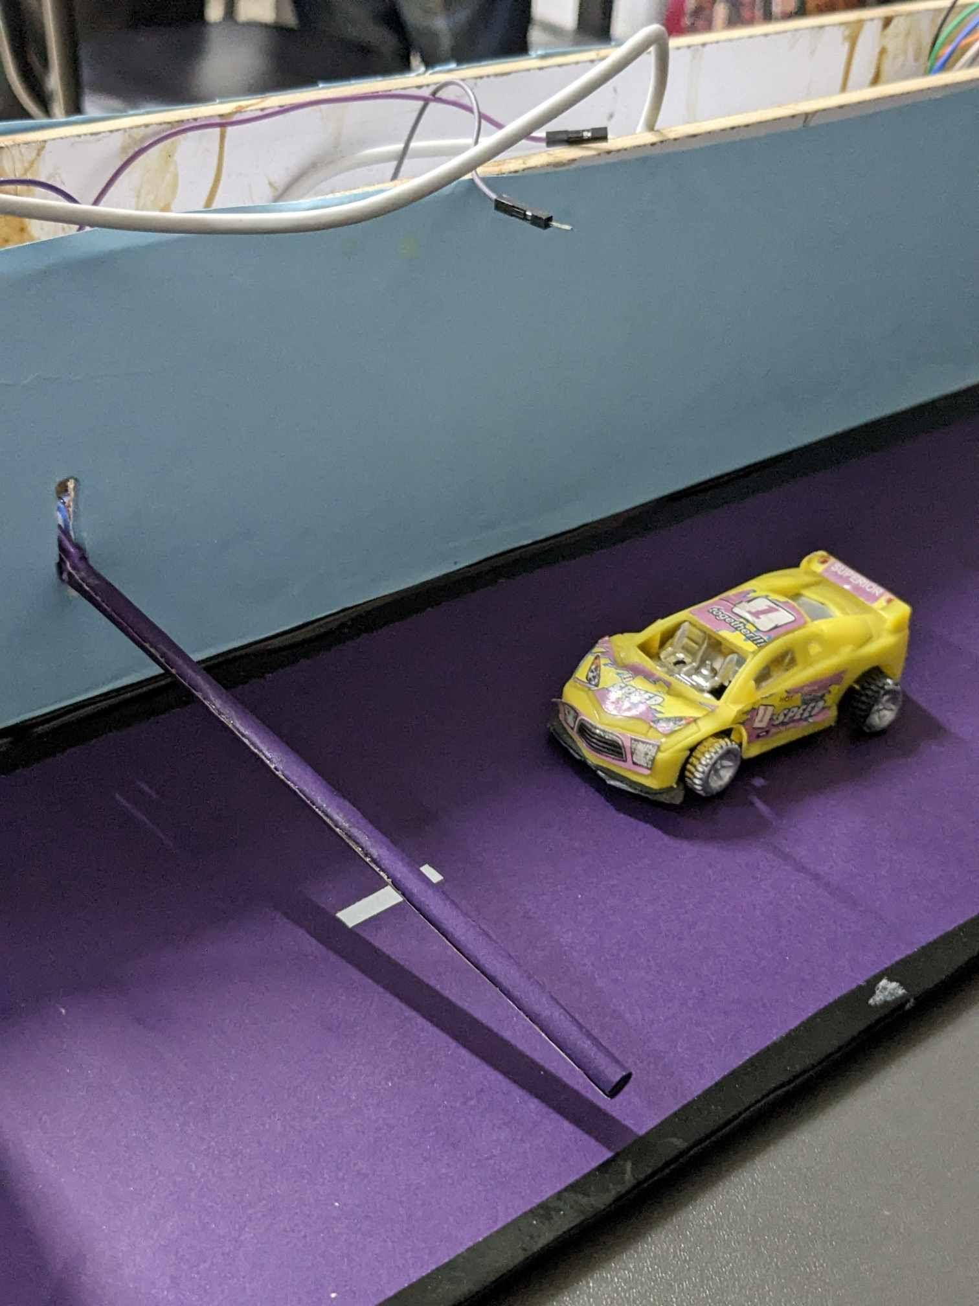
Features
Speed detection
Security Checking
Noise detection
Road Monitoring
Road information website

Slide 4
Features Description
Speed Detection:Utilizes sensors to monitor vehicle speeds.Data collected can also be used for traffic flow analysis, identifying congestion points, and optimizing traffic signal timings.
Security Checking:Incorporates surveillance cameras and advanced technologies like facial recognition or license plate recognition.
Noise detection: If the noise level is high than countdown will restart as punishment.
Road monitoring:There is a camera which will monitor the road.
Road information website:We have a website to collect all information .

Slide 5
Tentative Cost
Component name | Quantity | Price
ESP8266 | 1 | 420
ESP 32 | 1 | 640
IR sensor | 2 | 140
Sound Sensor | 1 | 60
Digital Display | 1 | 125
Arduino Uno | 1 | 800
Servo Motor | 1 | 150
Decoration+Wire | - | 500
Total Cost |  | 2825

Slide 6
Individual Contribution
Servo motor rotation:Mobarok Ali
IoT :Pallab Kumar Paroi,Mobarok Ali
Speed metre:Pallab Kumar Paroi
Camera :Radowan Ahemd,Pallab kumar Paroi
Sound Sensor:Shariar Rifat,Siyam Ahmed
Digital Display:Shariar Rifat
Design:Siyam Ahmed,Pallab kumar Paroi,Shariar Rifat,Radowan Ahmed,Mobarok Ali

Slide 7
In this feature, road barriers are controlled by an admin with the click of a button. The button click will be done by a user who decides to close the button or open the button after seeing the camera. The button can be seen on our website and here IoT is used. And this barrier will mainly handle security issues. And to implement this we need a servo motor, an ESP.

Slide 8
Future prospect
Traffic management systems will leverage AI to analyze real-time and historical speed data. This will allow for the identification of unusual speed fluctuations that might indicate accidents.
Future advancements in noise detection technology will enable more precise and intelligent monitoring of noise levels.
The future of road monitoring will witness the proliferation of advanced camera technologies, including high-resolution cameras, panoramic cameras, and even aerial drones for comprehensive coverage.

Slide 9
Hurdles faces & Overcome
Making camera sensor IDE errors with ESP32
Board Selection Error
Trying to implement the ESP32 camera using wrong components
Wifi connection error
Digital countdown by sound level
Display integration with the sound sensor
Can’t connect to database properly

Slide 10
Conclusion
In summing up the Smart Road Management System, the cool stuff we've talked about, like catching loud cars, watching roads with cameras, and having a website for road info, show us a glimpse of the future road world.
These things mean our roads are getting smarter. They're becoming safer and better at handling traffic. And they're doing it by using fancy technology and data to help everyone who uses the roads.
By keeping up with new tech and working together, we can make our roads even smarter. That means fewer accidents, less noise, and smoother journeys for everyone. So let's keep going and make our roads the smartest they can be!

Slide 11


